Slide 1
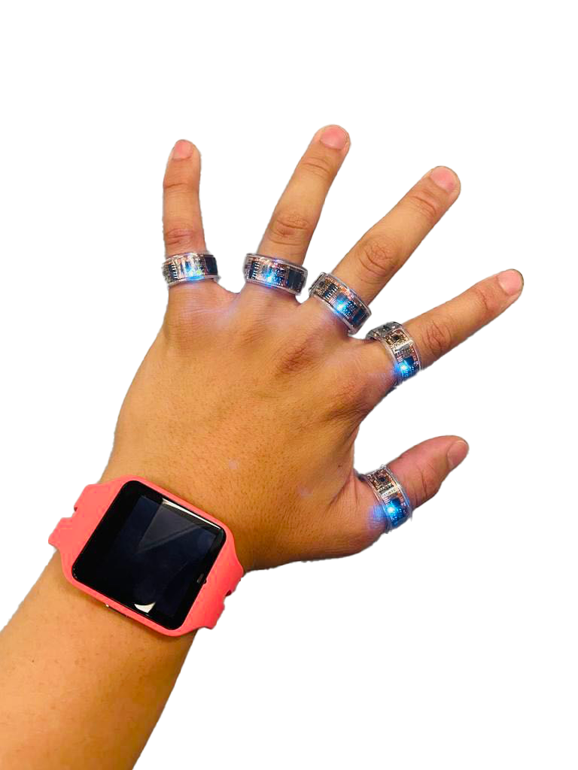

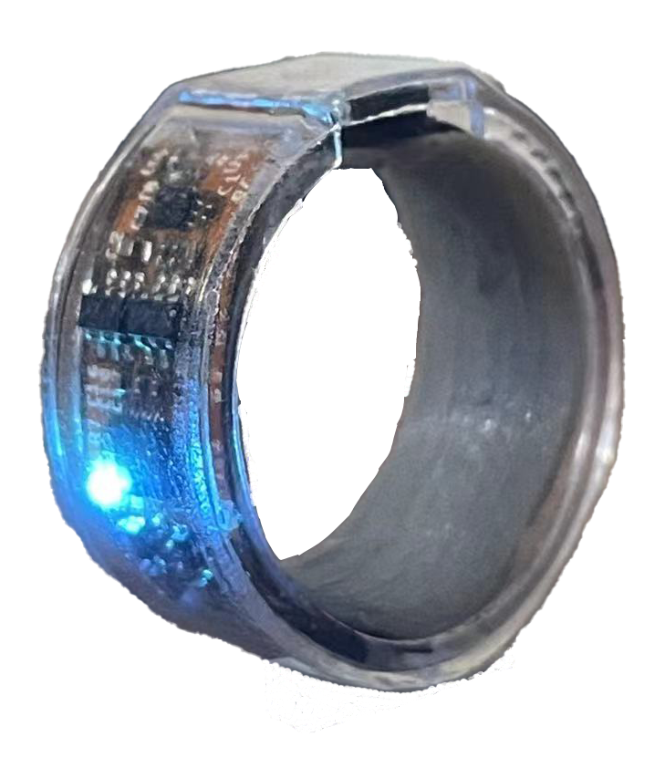
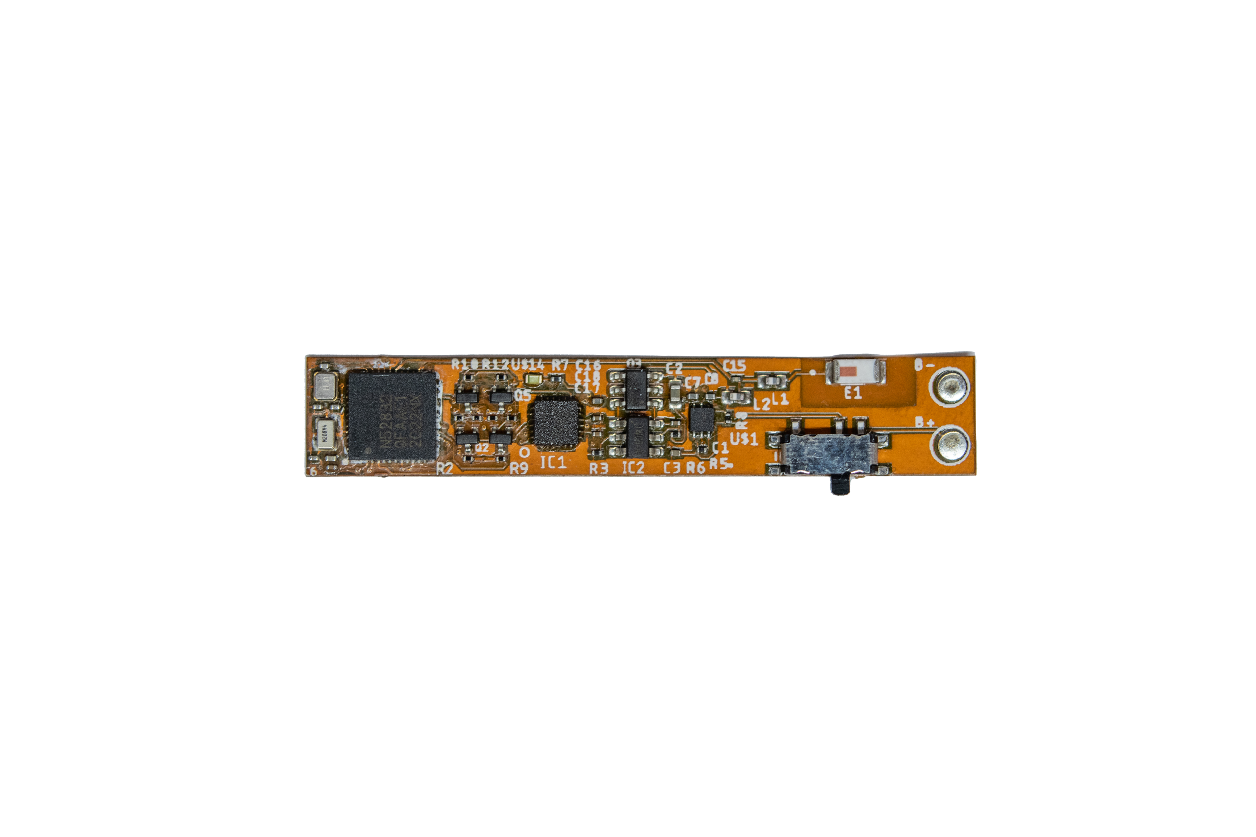
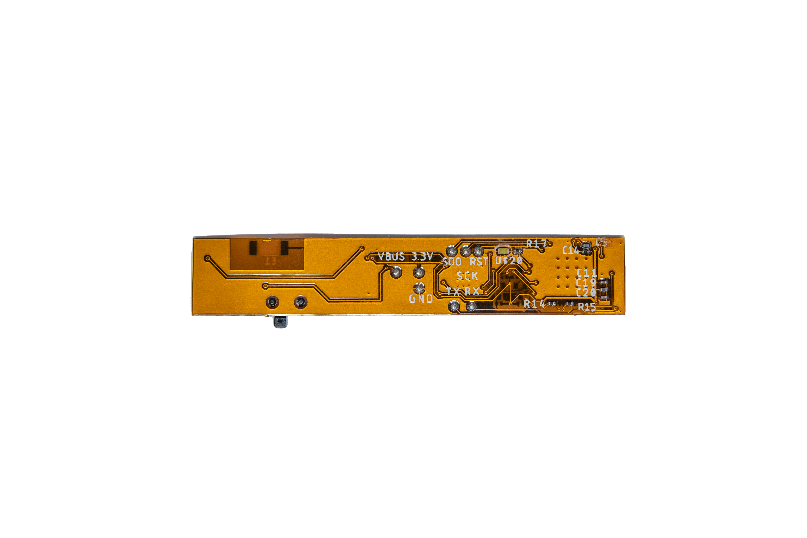
SPI
BLE
46.2 mm
Sensor Rings
9-axis
IMU
NRF52832
SoC
8.3
mm
Voltage regulator
Ring Diameter: 11mm
Battery: 15mAH
Weight: 2.8g
Lithium Battery
(a)
(b)
(c)

Slide 2
SPI
BLE
9-axis
IMU
NRF52832
SoC
I2C
PPG
Voltage regulator
Lithium Battery

Slide 3
SPI
BLE
SPI
BLE
9-axis
IMU
NRF52832
SoC
9-axis
IMU
NRF52832
SoC
I2C
I2C
ADC
PPG
Voltage regulator
PPG
Lithium Battery
ECG

Slide 4
BLE
SPI
NRF52832
SoC
9-axis
IMU
9-axis
IMU
NRF52832
SoC
I2C
PPG
PPG
Voltage regulator
Lithium Battery
ECG

Slide 5
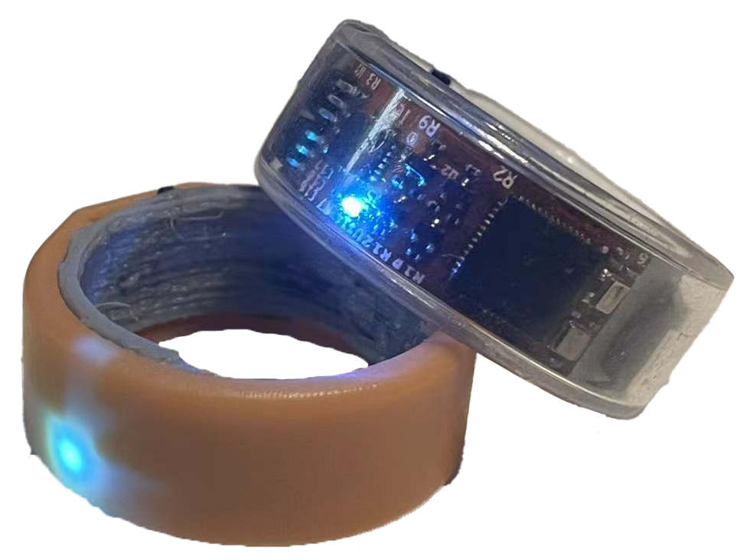
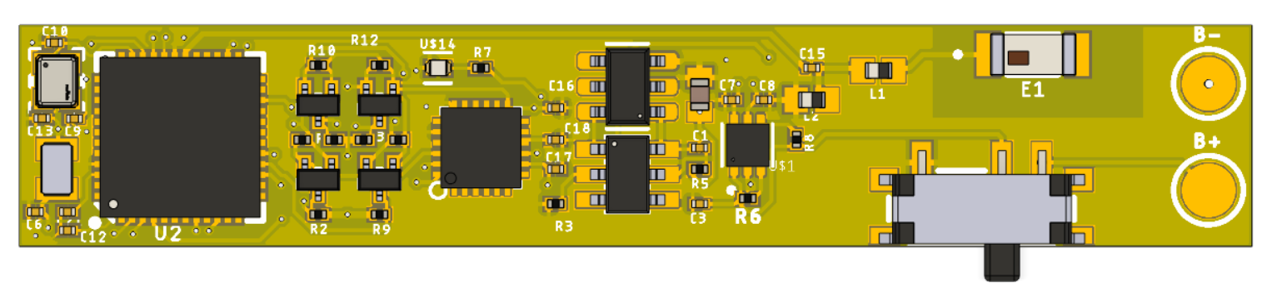
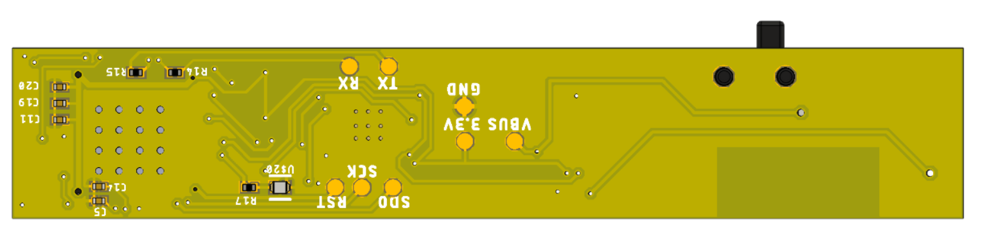
SPI
BLE
46.2 mm
Sensor Rings
9-axis
IMU
NRF52832
SoC
8.3
mm
Voltage regulator
Ring radius: 10mm
Battery: 15mAH
Weight: 2.8g
Lithium Battery
(a)
(b)
(c)

Slide 6
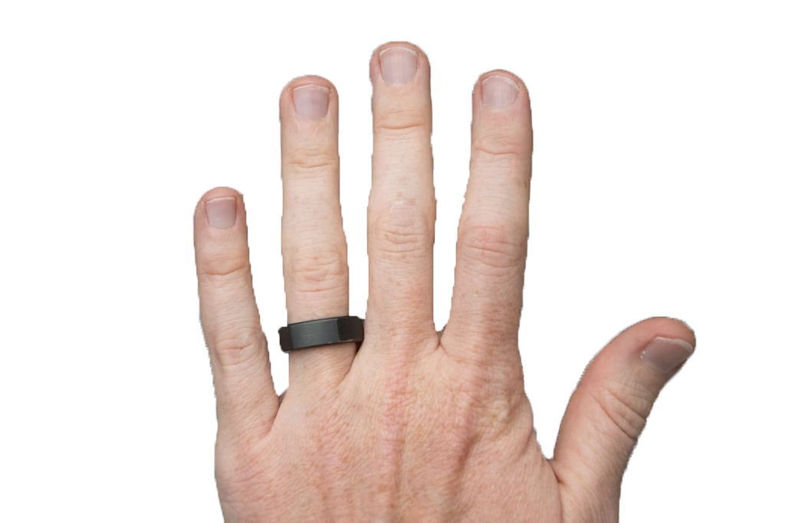
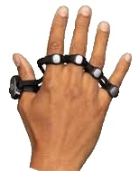
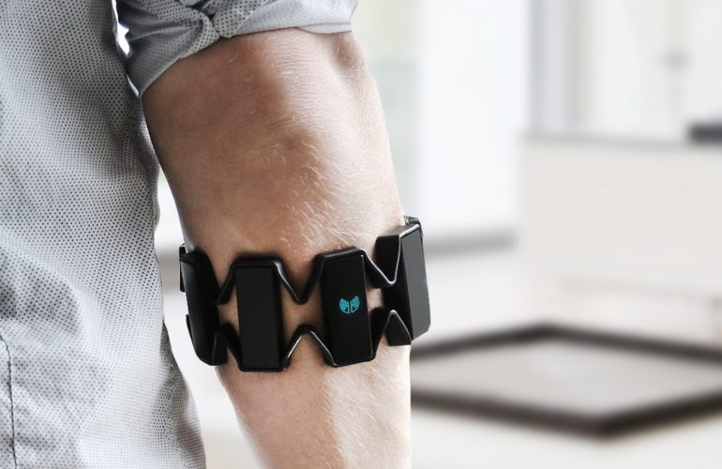
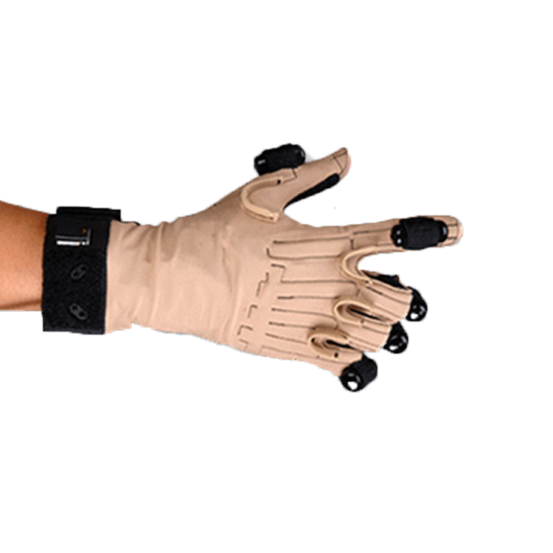
Ring (Zip)
Tapstrap
Platform
Comfort
Weight
Appearance
Platform
Comfort
Weight
Appearance
9.5
9.8
9.7
8.2
7.6
8.6
Myo EMG
CyberGlove
Platform
Comfort
Weight
Appearance
Platform
Comfort
Weight
Appearance
8.0
6.4
3.6
4.2
2.2
6.4

Slide 7
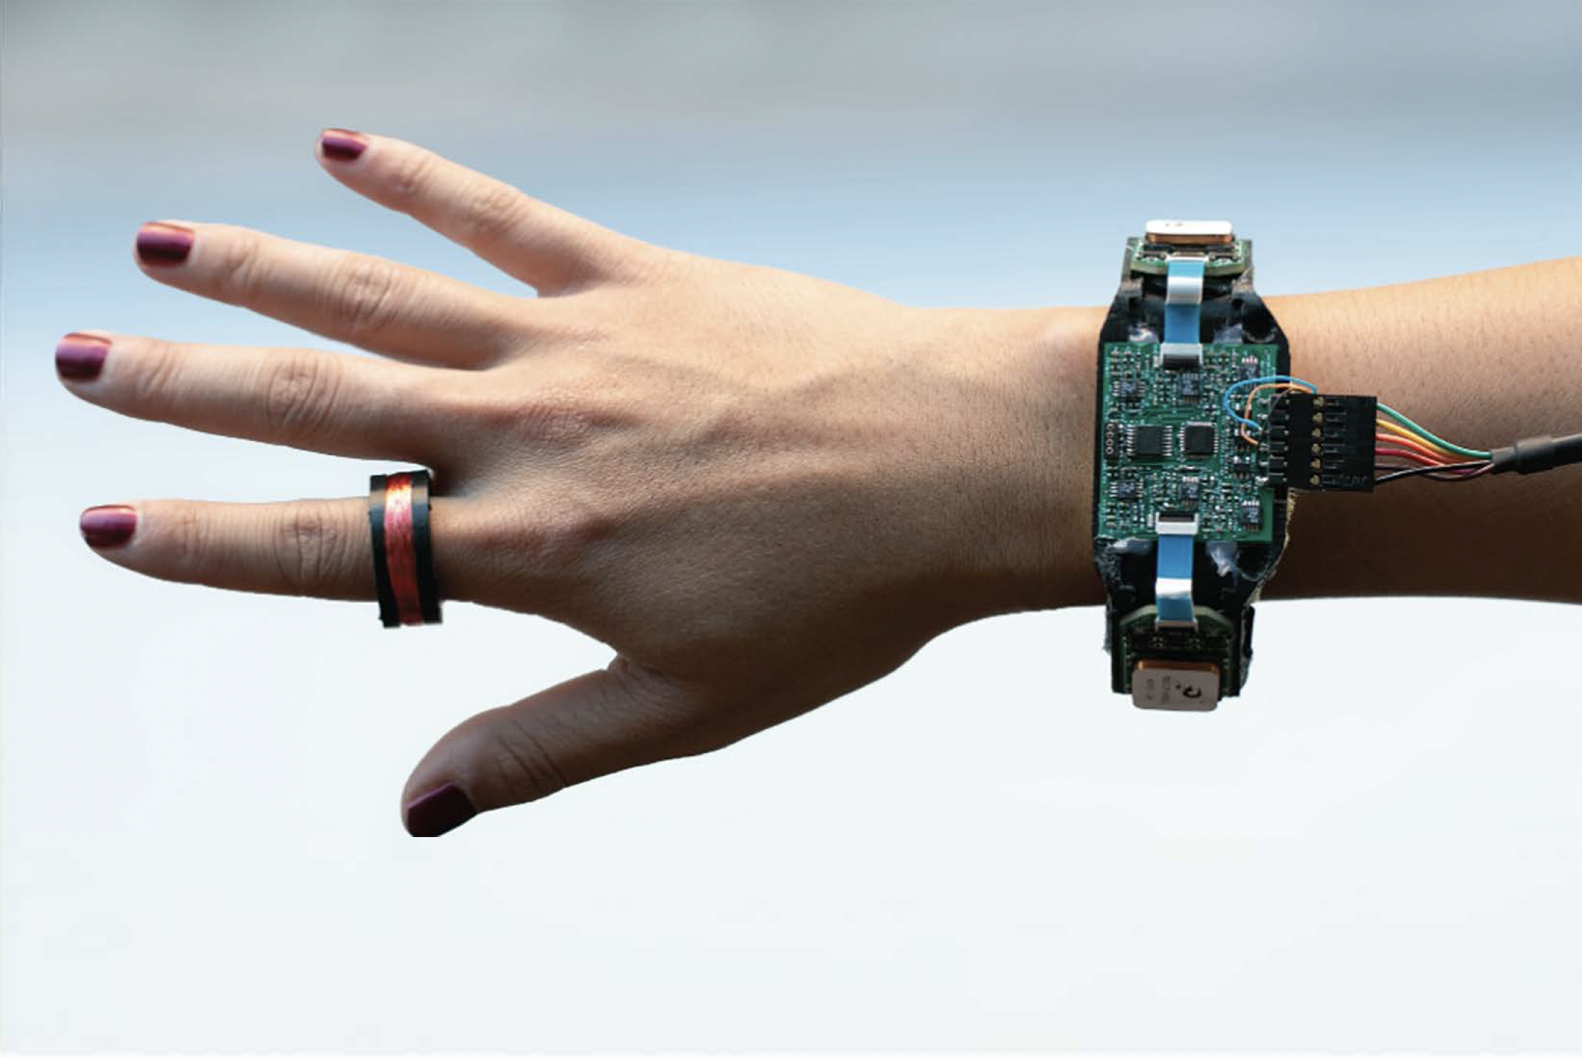
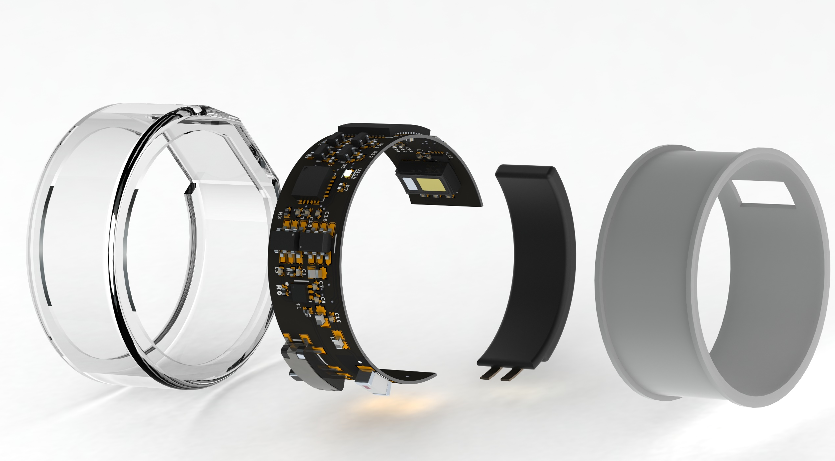
(a)
(b)

Slide 8
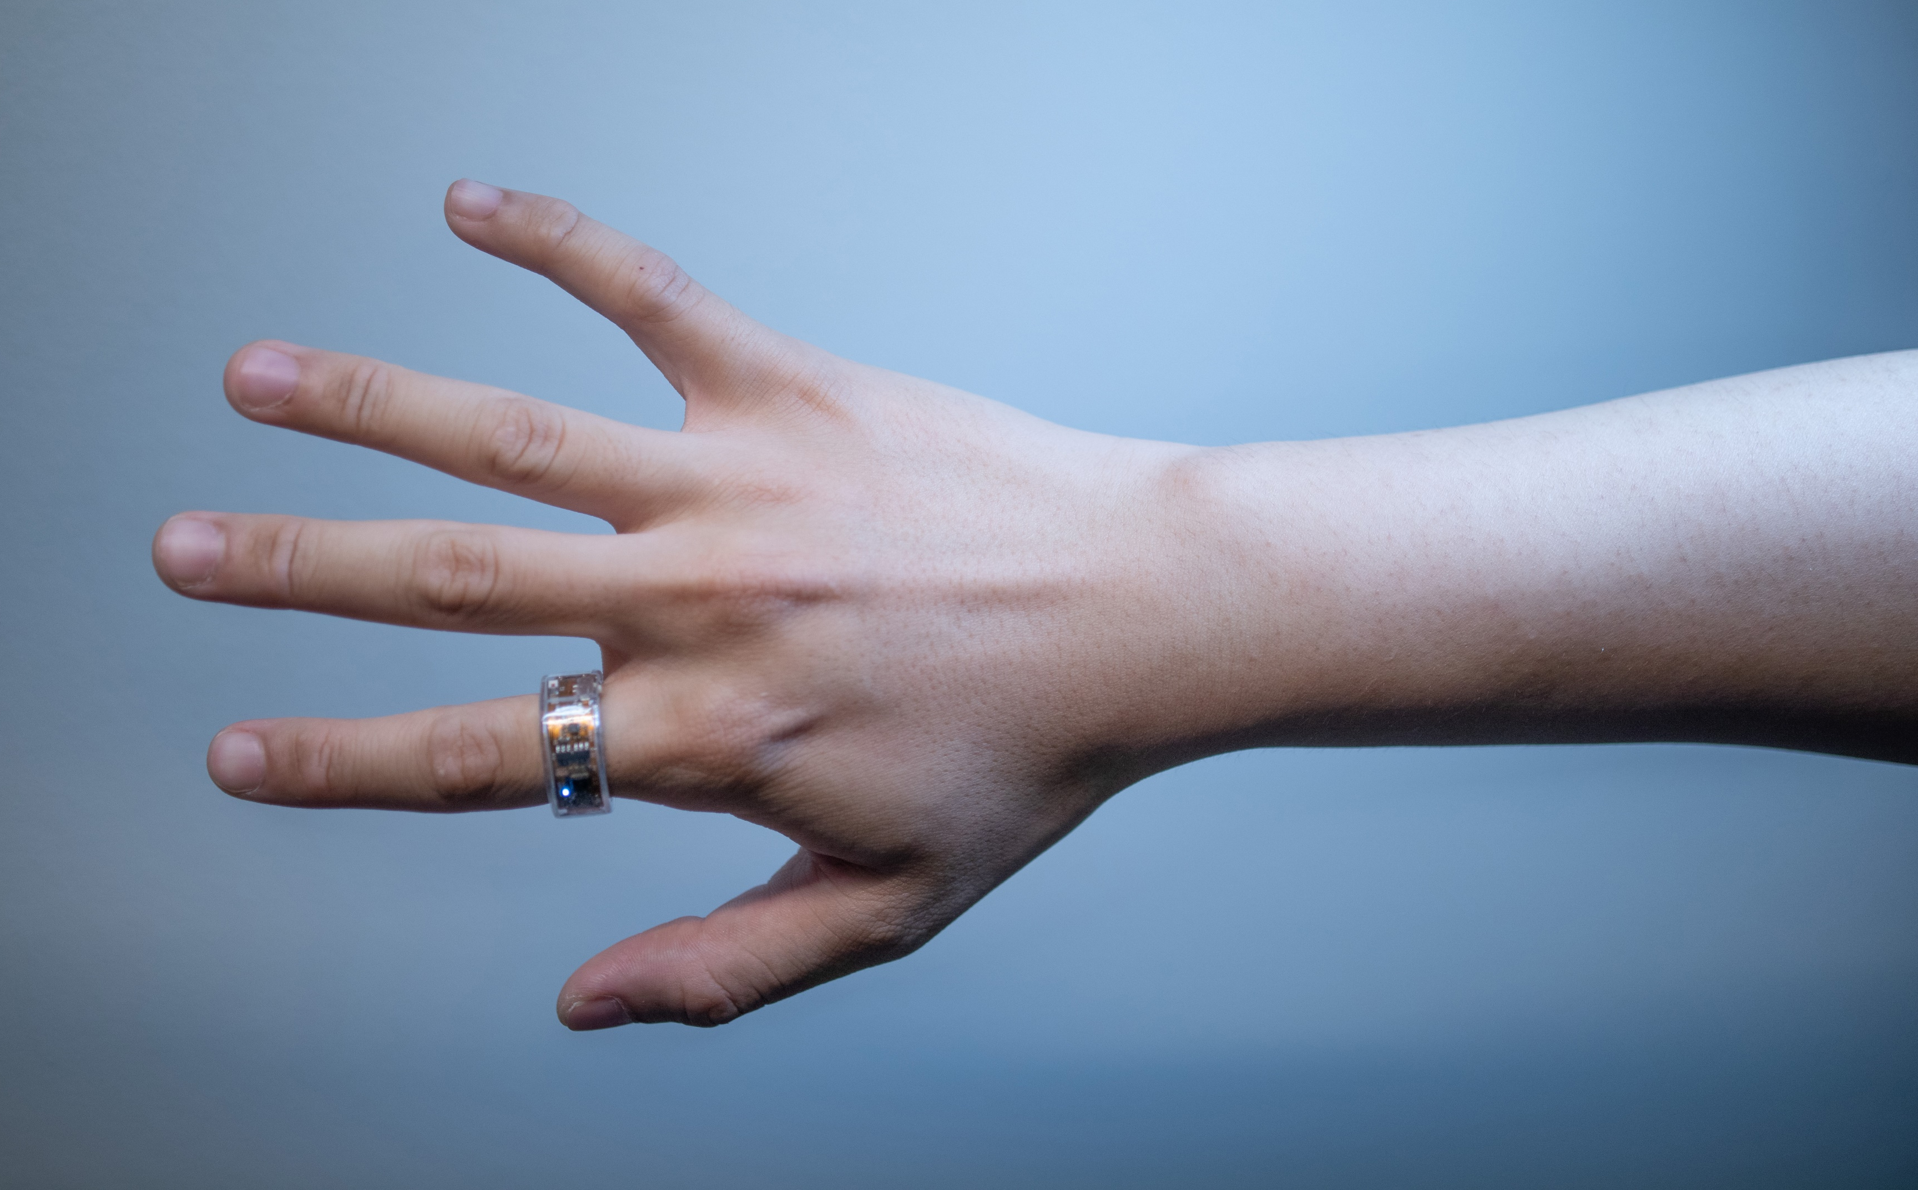

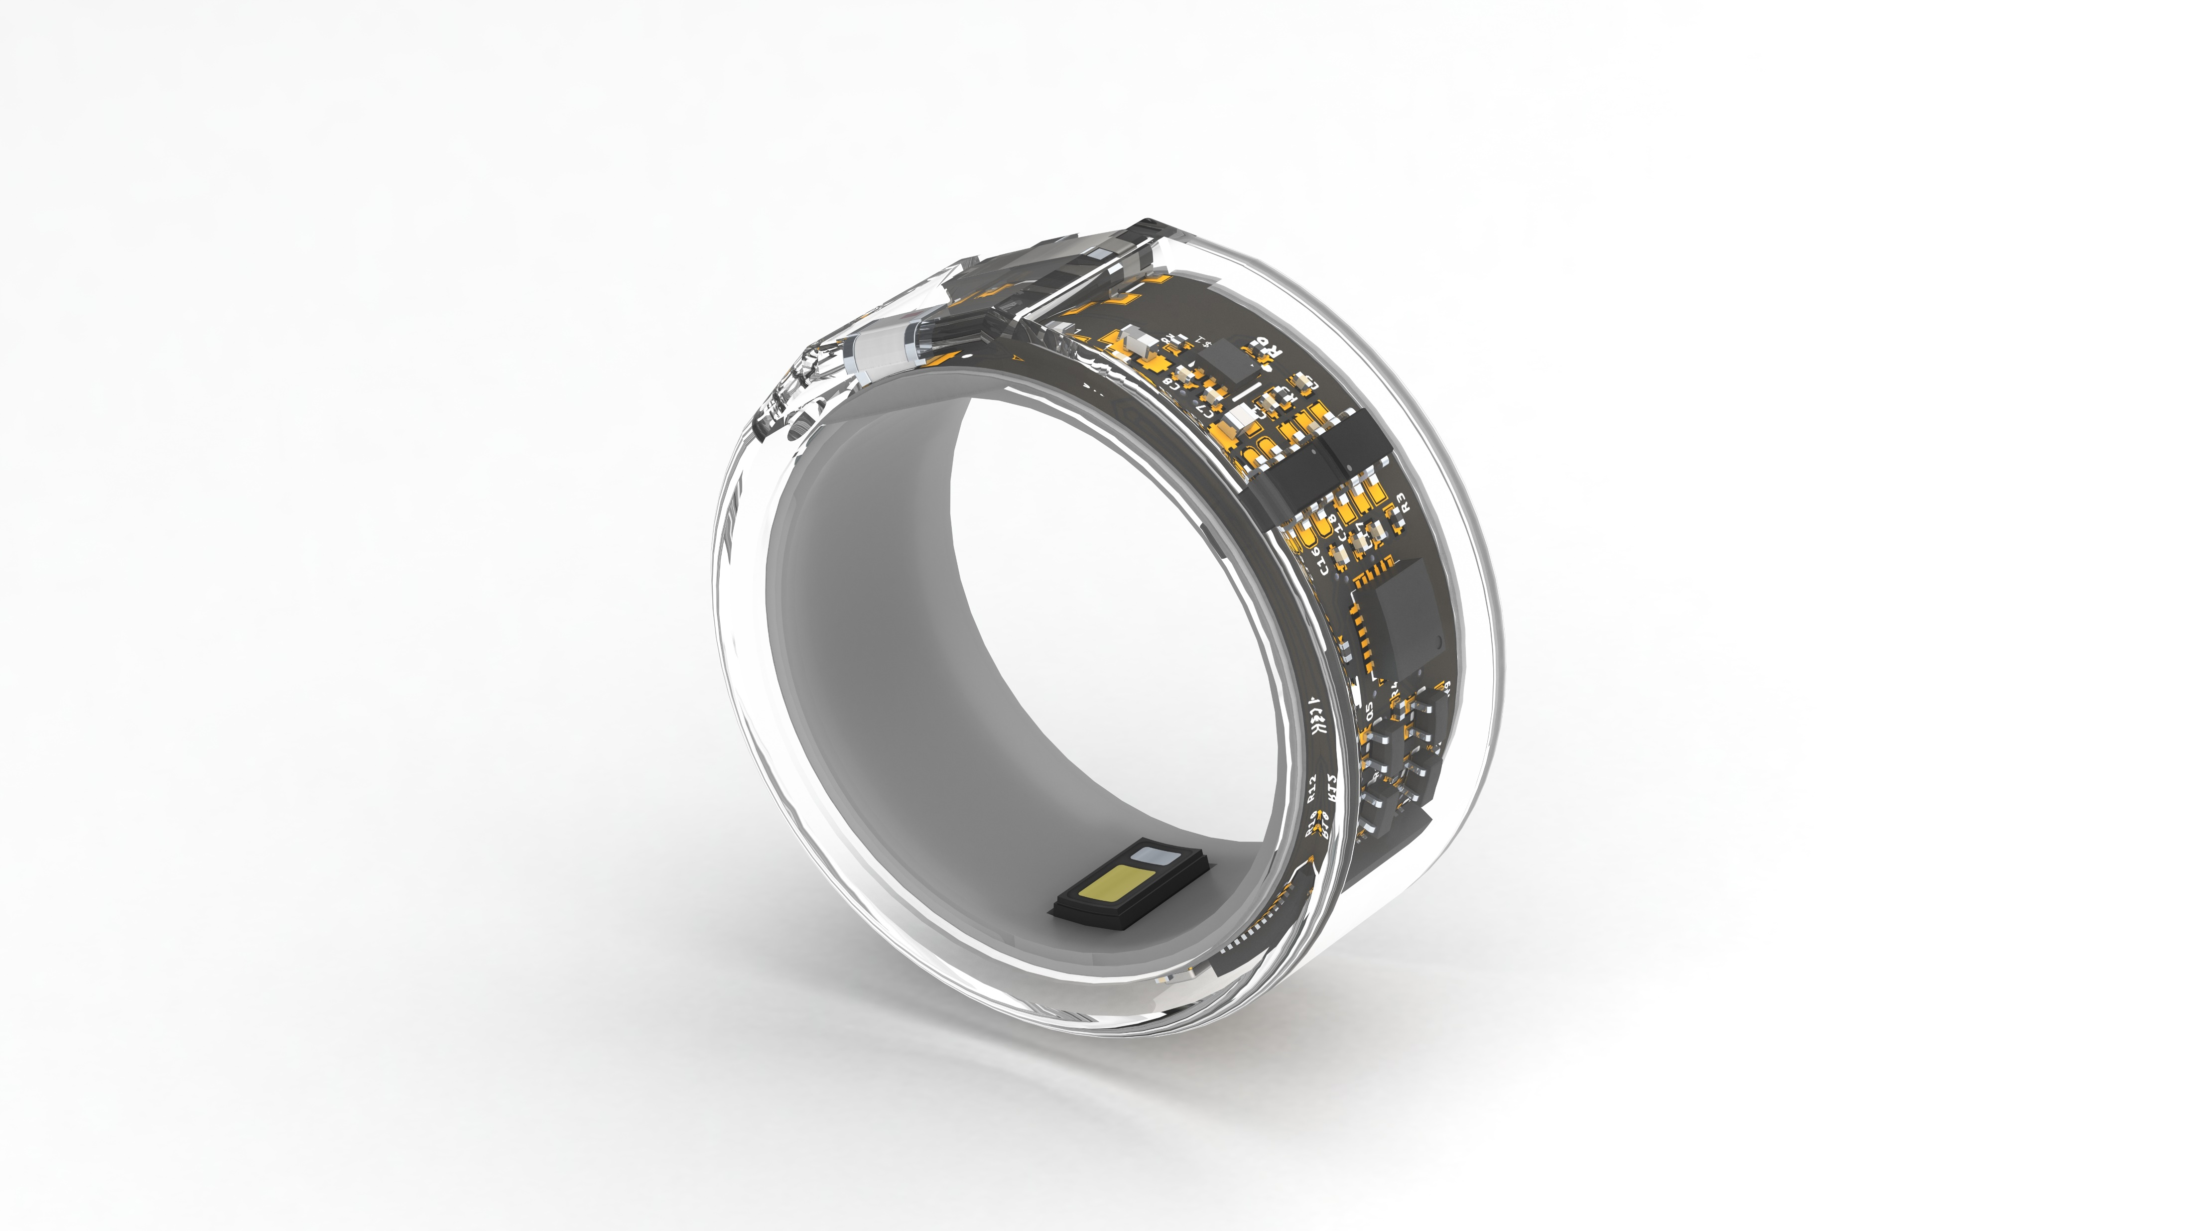


Slide 9

Ring Cover
Arc Battery
Main Board
Arc Battery

Slide 10

Ring Cover
Arc Battery
Main Board
Arc Battery

Slide 11

Outer Cover
Arc Battery
Main Board
Inner Cover

Slide 12
General
MCU
nRF52832 based, BLE 5.2
Sensors
PPG
Red, Green & IR channels
Maxim MAX30101
IMU
Accelerometer, Gyroscope & Compass
InvenSense ICM20948
Ring Cover
Arc Battery
Actuator
LED
Brightness programmable
Main Board
Arc Battery

Slide 13
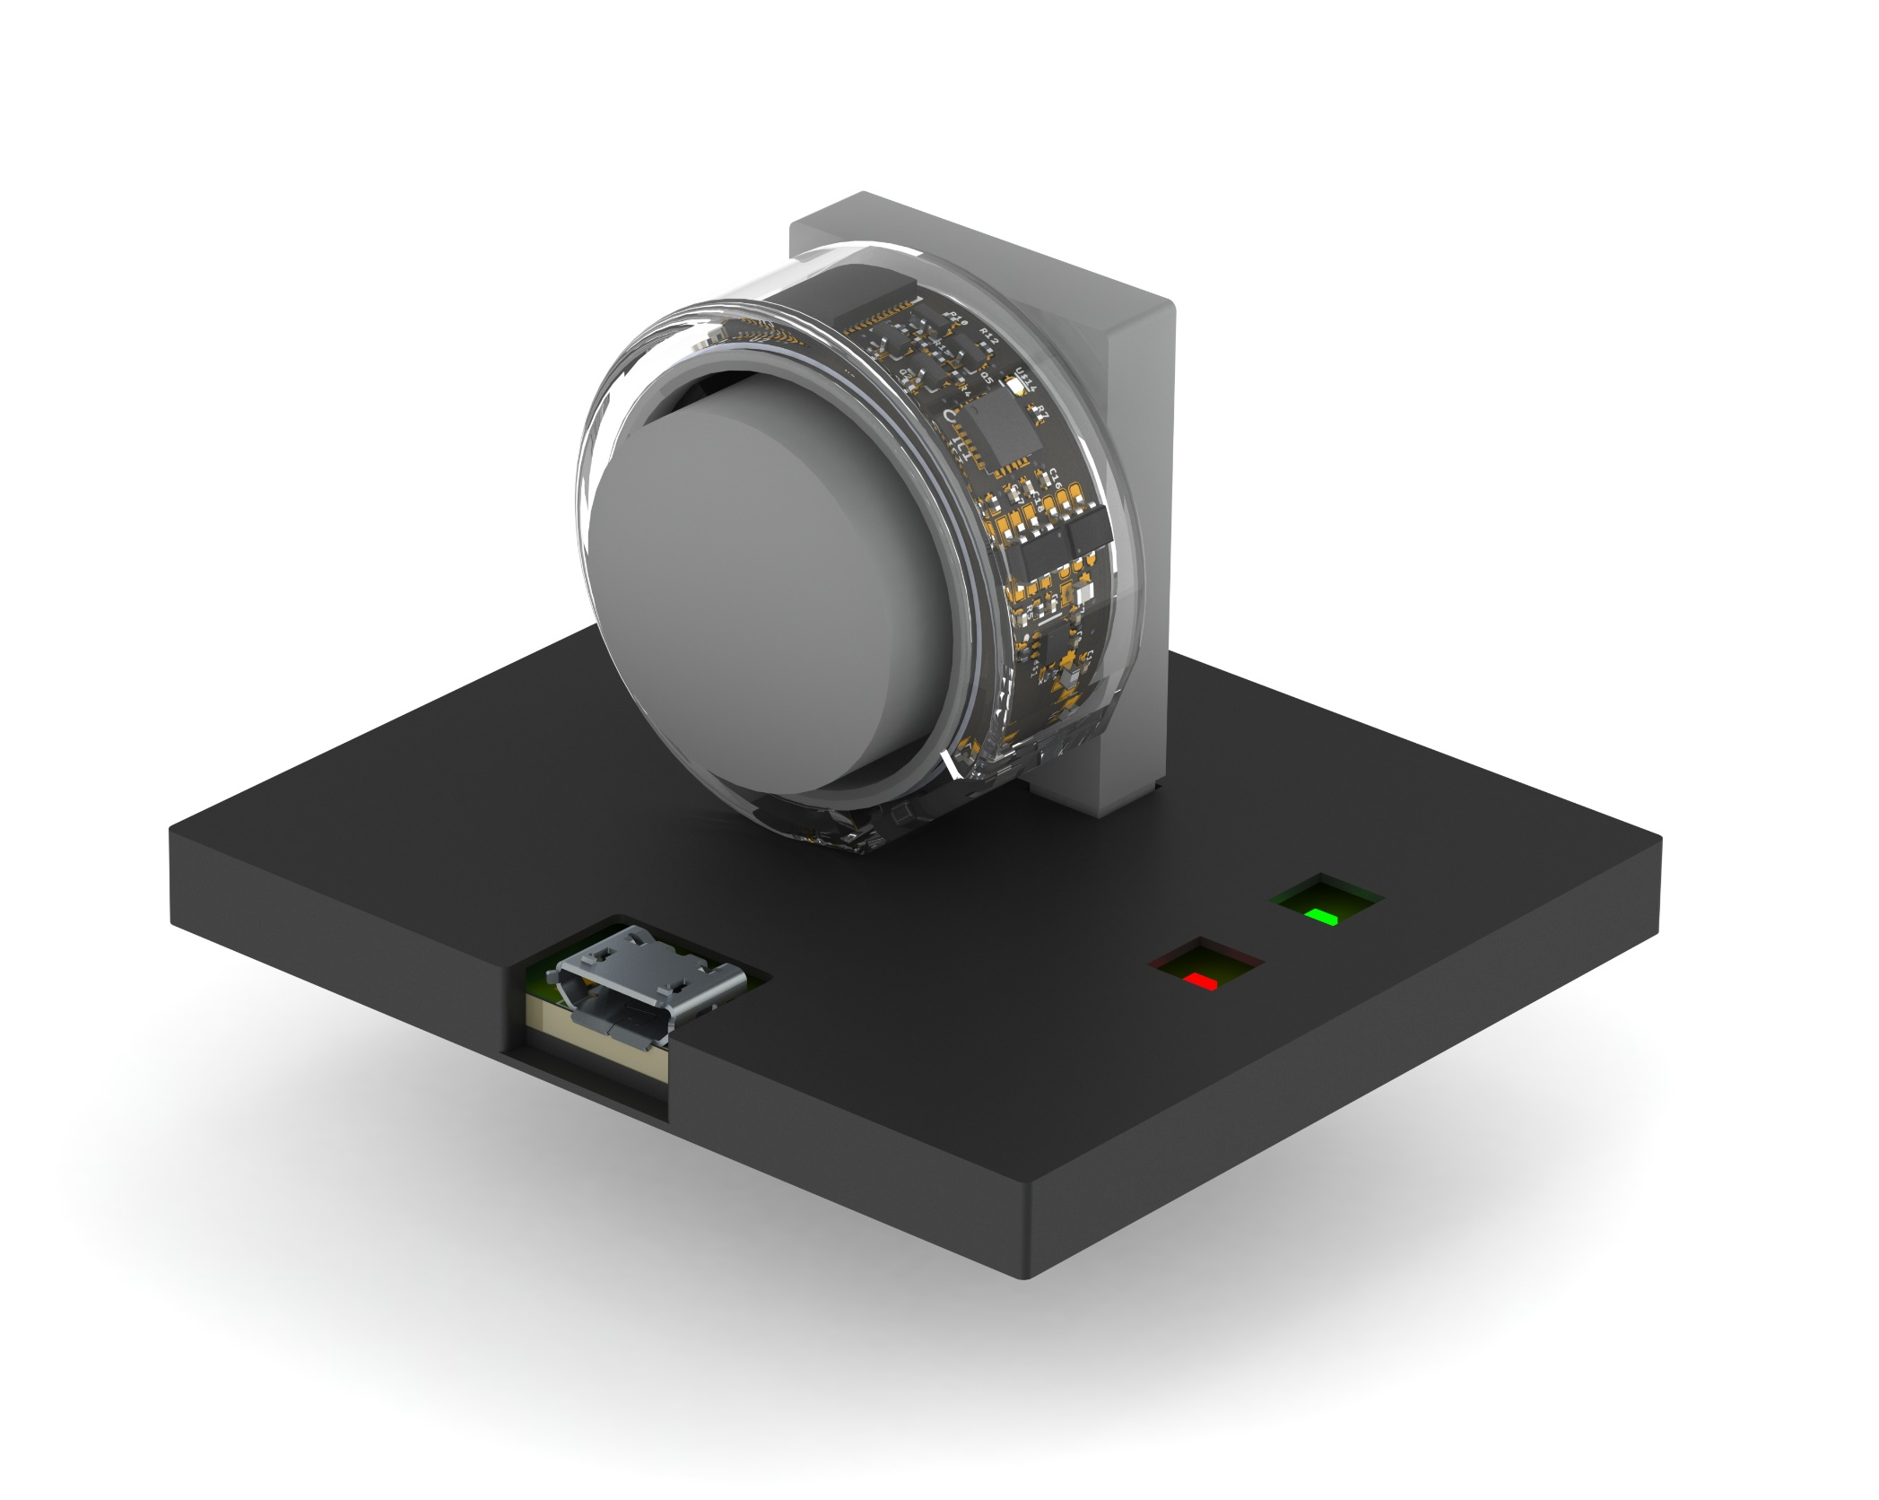
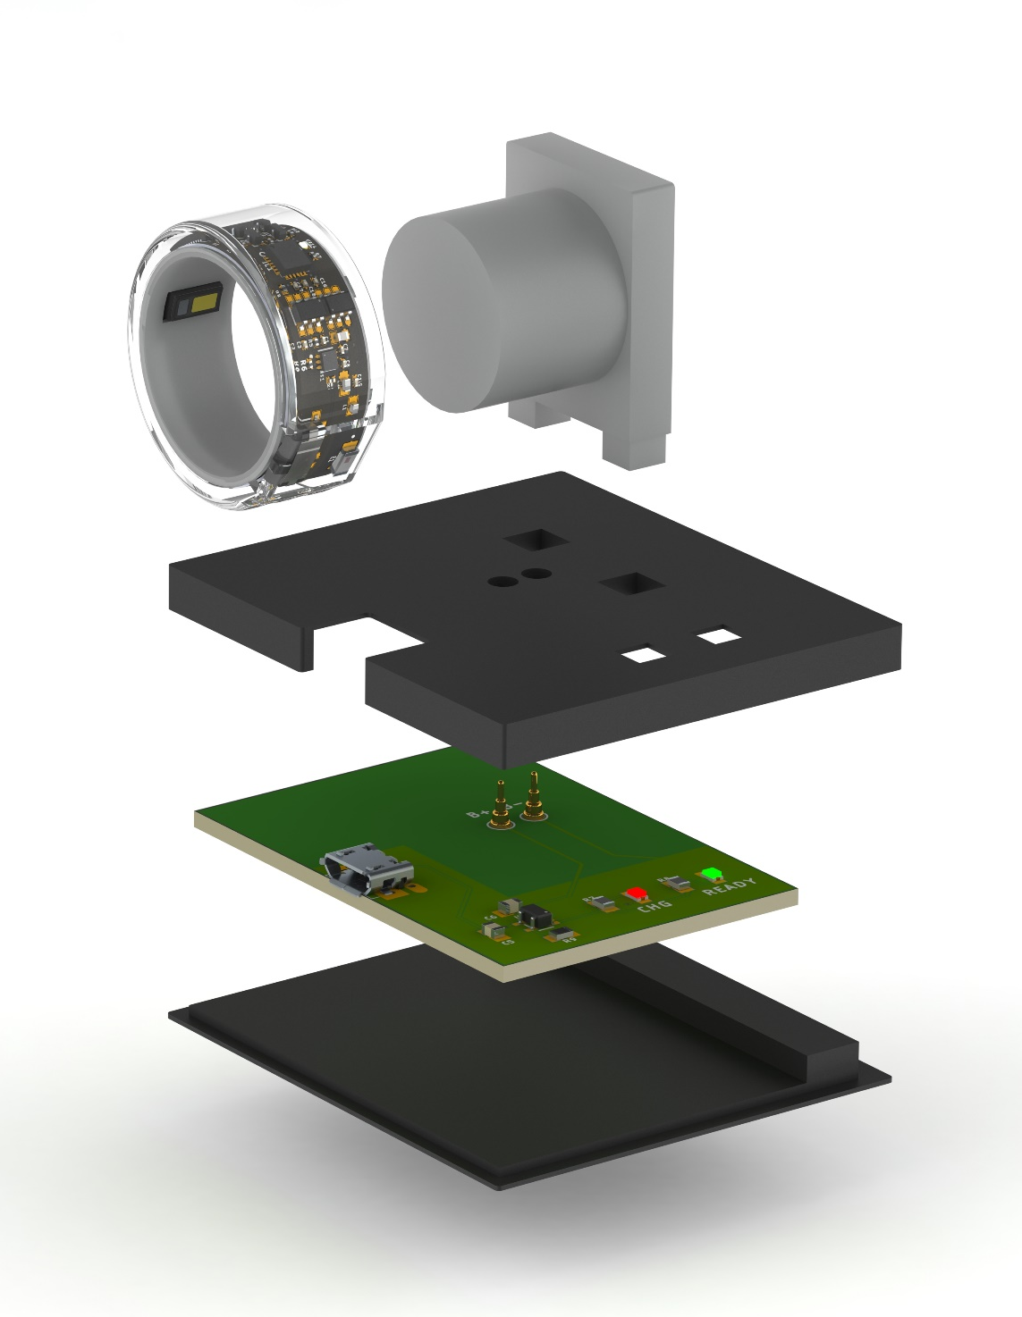
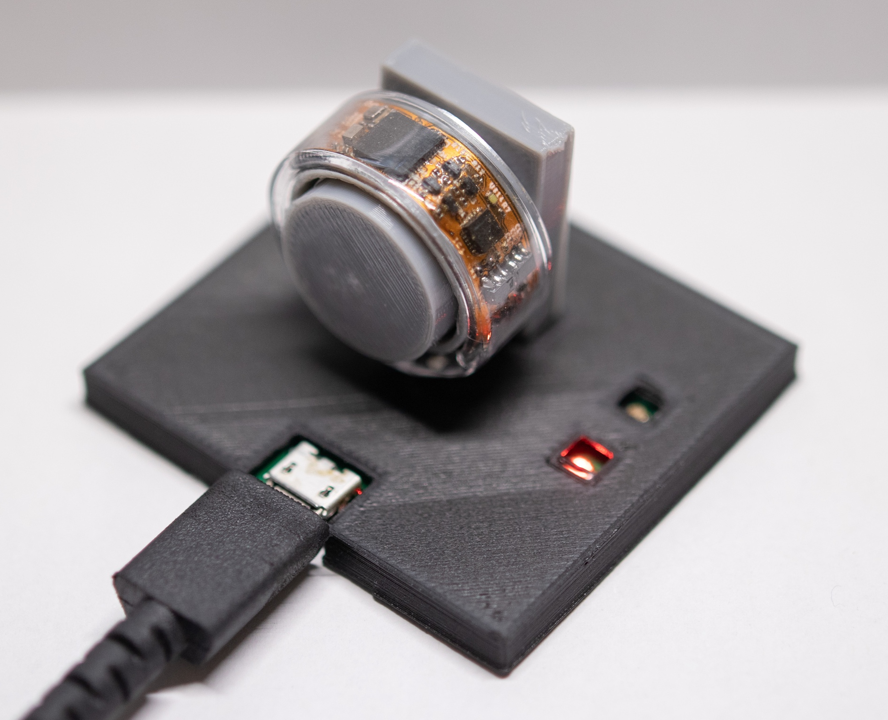

Slide 14
Voltage Regulator
Microcontroller Unit
(nRF52832)
BLE 5.2
wireless
BLE Central
Battery
SWD
Solder
Pads
Debugger
USB 5V
Solder
Pads
Charging Controller
I2C Bus
SPI Bus
GPIO
PPG
(MAX30101)
IMU
(ICM20948)
LED
Green
Accelerometer
E xternal
Actuators
Red
Gyroscope
Power
IR
Compass
Sensor

